Slide 1
OpenTok Video Issues and Solutions
With prototype implementation

Slide 2
OpenTok Basics I
A session connection is created by a client that connect to a particular session. All clients connected to the same session can “see” each other, thus can have video/audio conversations.
Call OpenTok new session API to create a sessionId and two session tokens. A sessionId identifies a session with a timeout of 24 hours. A token identifies a participating party.

Slide 3
OpenTok Basics II
Clients communicate by publishing and subscribing to streams.
Publishing requires a session connection, but it does not require network. Publishing creates a publisher. A publisher object gets destroyed when a session connection is gone or when unpublished.
Subscribing requires a session connection and a foreign stream. A subscriber object gets destroyed when session connection is gone or the underling stream is destroyed.

Slide 4
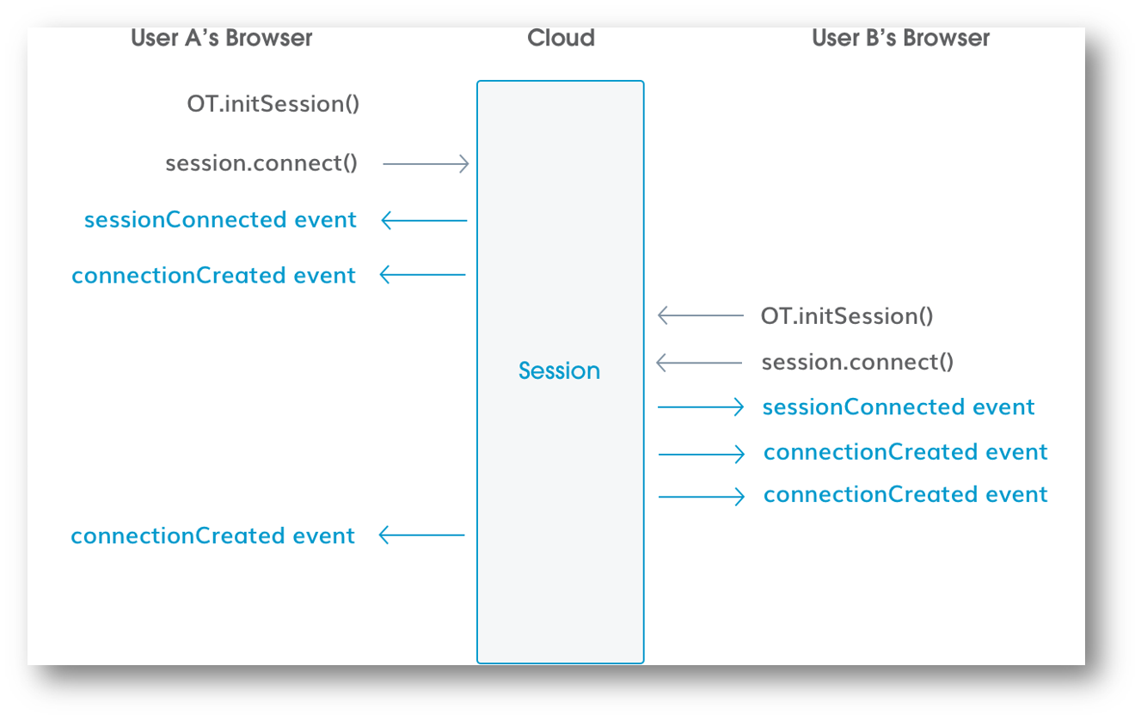
Sequence of Events - Connect

Slide 5
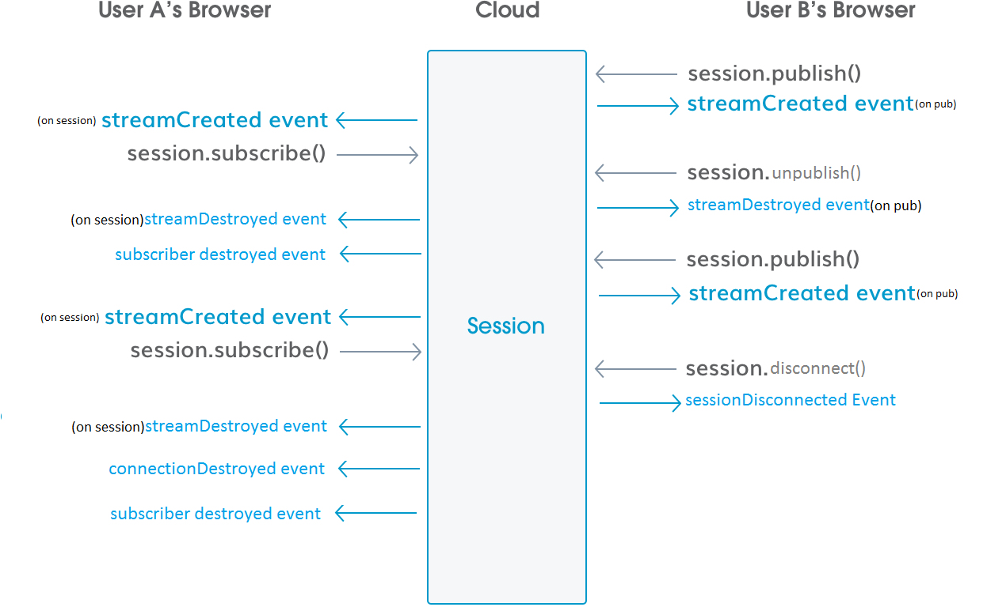
Sequence of Events – Pub & Sub

Slide 6
Potential Sources of Problem
Publish could cause one or more streamCreated events (I’ve see 2, 3 or 4 of them).
When network is disrupted, openTok will try to re-establish the connection once, then it will disconnect. The timeout is about 60 s.
When a new connection is created, we will have a new id. But the other side might not get connectionDestroyed event for the first one yet (timing issue).
Video could be disabled under certain situations (packet loss, after reconnection), it can take minutes for openTok to re-enable it.
Documentation does not reflect the actual code. For example, session.currentState is not in doc.
Inadequate dynamic video/audio adjustments.
On Firefox TURNS is not yet supported.

Slide 7
Potential Sources of Problem - cont
Timing issues. For example, Connection timeout: 60s, streamDestroyed, 65s for self sessionDisconnected, then about 105s for connectionDestroyed.
A stream could be created before the old one is removed. This can cause new subscription to fail (with error 12).

Slide 8
Potential Customer Problems
Connectivity problems. With short network interruption openTok can re-establish connection under certain situation (not 100%). With interruption of more than 1 m openTok will not re-establish connection.
Video quality problems:
OpenTok can disable video for longer time than necessary.
Frame rate and resolution dynamic adjustments less than optimal.

Slide 9
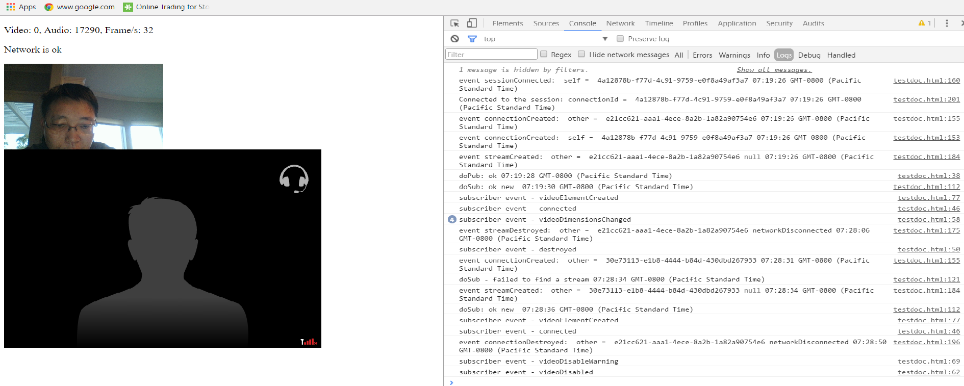
When Video is Disabled

Slide 10
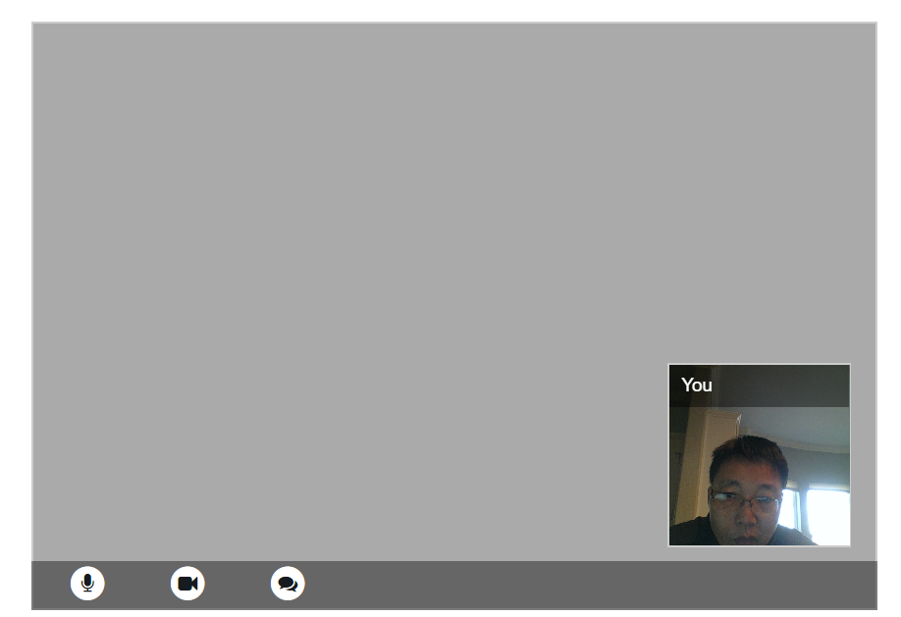
After Session is Disconnected

Slide 11
Connectivity Issues
With short interruptions, openTok might or might not be able to recover (depending on the network – same or different).
With longer interruptions (>1m) openTok will not recover(by design).
Currently we do not handle recovery beyond what openTok does. Which means with any network interruption, customer will most likely lose video/audio stream.

Slide 12
Connectivity Solution
Initially we’ve tried to rely on the events to recover from interruption. The strategy proves to be unreliable (may work 50-70% of the time) because:
the un-reliability of the events (sometimes not fired, sometimes got more than one).
Might create multiple publishers and/or subscribers.
slowness and possible timing issues of events.
A monitoring strategy is implemented. After thorough testing, it is proven to be faster and more effective. Reliability is more than 95%.
Take advantage of the signaling support from openTok for effective monitoring of network connection.

Slide 13
More problems
The mystery for the connection from an unknown user appear to be a second connection from the same user using the same token (probably on the same machine). Apparently opentok is not handling that situation and yet not preventing that from happening.
If the patient and doctor logged in from the same machine, they will both be identified as user1.
When multiple users are identified as the same user, events might be messed up, for example when closing browser, no disconnect events are fired. Only when closing all of the browser, then a single publisher destroyed event is fired (reason disconnect), but no disconnect event is detected.

Slide 14
Connectivity Solution – code snippet
var prevStats;
var intervalId = window.setInterval(function () {
var cur = new Date();
var connected = true;
if (cur - lastSignal > 5000)
{
document.getElementById("id_network").innerHTML = "<P>Network is lost with the other party.</P>";
connected = false;
}
else
document.getElementById("id_network").innerHTML = "<P>Network is up</P>";
if (endSession) {
window.clearInterval(intervalId);
return;
}
if (session != null && session.currentState == "connecting")
{
console.log("Interval - session is connecting", (new Date()).toTimeString());
return;
}
if (session == null || session.currentState == "disconnected") {
connect_session();
return;
}

Slide 15
Connectivity Solution – code snippet cont
session.signal(
{
data: "hello",
type: “ping"
},
function (error) { });
var a = document.getElementsByClassName("OT_mirrored OT_root OT_publisher OT_fit-mode-cover");
if (a.length == 0 || publisher == null || publisher.session == null) {
doPub();
return;
}
x = document.getElementsByClassName("OT_root OT_subscriber OT_fit-mode-cover");
if (x.length == 0 || subscriber == null || subscriber.stream == null) {
if (connected)
doSub();
return;
}
subscriber.getStats(function (error, stats) {
if (error)
doSub();
else if (prevStats && (typeof stats.video !== 'undefined')) {
var videoBitRate = 2 * (stats.video.bytesReceived - prevStats.video.bytesReceived);
var audioBitRate = 2 * (stats.audio.bytesReceived - prevStats.audio.bytesReceived);
document.getElementById("id_status").innerHTML = "<P>Video: ".concat(videoBitRate.toString(), ", Audio: ", audioBitRate.toString(), ", Frame/s: ", stats.video.frameRate, "</P>");
}
prevStats = stats;
});
}, 2000);

Slide 16
Video Quality Improvement
By capturing videoDisabled event on subscriber, we can quickly re-enable the video.
OpenTok disables video when serious package loss is detected. But in reality, this happens mostly during short network interruption. When the network is back, video should be resumed.

Slide 17
Future Video Quality Improvements
More refined video quality control.
We will have to disable openTok’s default video quality control.
Proactively adjust frame rate, disable/enable video, raise/lower resolution.
Give one channel preference over the other. For example we may want the doctor to see the patient more. We could stop clinician from publishing stream when network is slow.

